Slide 1
SMART ENEGRY METER
Presented by:
PRANEETH B - CB.SC.U4AIE24109
MEERA S - CB.SC.U4AIE24133
MITHUL AKSHAY - CB.SC.U4AIE24135
MOHAN INNANI - CB.SC.U4AIE24136

Slide 2
INTRODUCTION
In this project, we will learn how to make our own IoT-Based Electricity Energy Meter using ESP32 & monitor data on the Blynk Application.
A Smart Energy Meter is an advanced electricity monitoring system that measures and records real-time power consumption.
This project integrates an ESP32 Wi-Fi module with voltage and current sensors to accurately calculate energy usage and transmit data to the Blynk IoT platform for remote monitoring
The system consists of a ZMPT101B AC Voltage Sensor to measure voltage and an SCT-013 Non-Invasive AC Current Sensor to measure current. The ESP32 processes these readings to compute power and energy consumption.
A 16x2 LCD display (optional) provides real-time local monitoring, while users can access data remotely through the Blynk app on mobile devices or laptops.
This smart meter helps save energy by showing how much power is being used. It is useful for homes and businesses to track and manage electricity consumption.

Slide 3
METHODOLOGY
1. AC Power Supply (230V AC Input)
Main electrical power source supplying 230V AC to the system.
Sensors measure voltage and current from this power supply.
Low-voltage components like ESP32 operate using regulated DC power from an adapter or voltage regulator.

Slide 4
METHODOLOGY
2. Voltage Measurement – ZMPT101B AC Voltage Sensor
The ZMPT101B AC Voltage Sensor is used for precise AC voltage measurement. It uses a high-precision voltage transformer and an operational amplifier circuit to step down and isolate the AC voltage, making it safe for microcontrollers like the ESP32 to process.
Voltage Sensing:
The ZMPT101B contains a miniature electromagnetic transformer that detects AC voltage from the mains supply.
Signal Conditioning:
The sensor module includes an operational amplifier, which converts the transformer's output into a readable analog signal.
It also amplifies and filters the signal to improve accuracy.

Slide 5
METHODOLOGY
3. Analog Output:
The module outputs an AC waveform as an analog voltage signal.
This signal is typically centered around a mid-range voltage (2.5V for a 5V system).
4. Microcontroller Processing (ESP32):
The ESP32 reads the sensor’s output using its ADC (Analog-to-Digital Converter).
The actual AC voltage is derived from the waveform using sampling techniques and RMS calculations.
5. Power and Energy Calculation:
Once voltage readings are obtained, they can be combined with current measurements (from SCT-013) to calculate real-time power consumption (P = V × I) and energy usage over time.

Slide 6
METHODOLOGY
3. Current Measurement – SCT-013 Non-Invasive AC Current Sensor
SCT-013 AC Current Sensor
The SCT-013 is a clamp-type, non-invasive AC sensor that measures current without direct contact, using electromagnetic induction like a transformer.
Electromagnetic Induction:
AC flowing through a conductor generates a changing magnetic field.
This induces a proportional current in the sensor’s internal coil (per Faraday’s Law).
Signal Conversion:
A resistor converts the induced current into a measurable AC voltage signal.
ESP32 Processing:
The ESP32 reads the AC voltage via its ADC, samples it, and applies RMS calculations to derive the actual current in amperes (A).
Power & Energy Calculation:
Combining the current from the SCT-013 with the voltage from the ZMPT101B, the ESP32 computes real-time power (P = V × I) and tracks energy consumption over time.

Slide 7
METHODOLOGY
4. Data Processing – ESP32 Wi-Fi Module
The ESP32 is the main processor that handles sensor readings and calculations.
Reads analog signals from the voltage and current sensors.
Computes:
Power (Watts) = Voltage × Current
Energy Consumption (kWh) = Power × Time
Formats the data for both local display and remote transmission.
Also functions as a Wi-Fi module for cloud communication.

Slide 8
METHODOLOGY
5. Local Display – 16x2 LCD (Optional but Useful)
The 16x2 LCD display shows real-time voltage, current, power, and energy locally.
It is connected to the ESP32 via I2C communication, allowing efficient data transfer.
This is useful for quick on-site monitoring without needing an internet connection.
6. Data Transmission – Blynk IoT Platform
The ESP32 connects to Wi-Fi and sends data to the Blynk cloud server.
The Blynk IoT platform provides a real-time dashboard for data visualization.
Allows users to monitor energy usage remotely.

Slide 9
METHODOLOGY
7. User Interface – Mobile Devices / Laptops
Users can view energy data via the Blynk mobile app or web dashboard.
Displays:
Live voltage, current, power, and energy.
Graphs and trends for better energy consumption analysis.
Helps track and manage electricity usage efficiently.
The smart energy meter automates power monitoring and provides real-time data.
The ESP32 acts as the central processor, handling sensor data and cloud communication.
Voltage and current sensors provide essential measurements, while the LCD and Blynk app enable easy visualization.
Both residential and industrial users can benefit from better energy management and reduced power wastage.

Slide 10
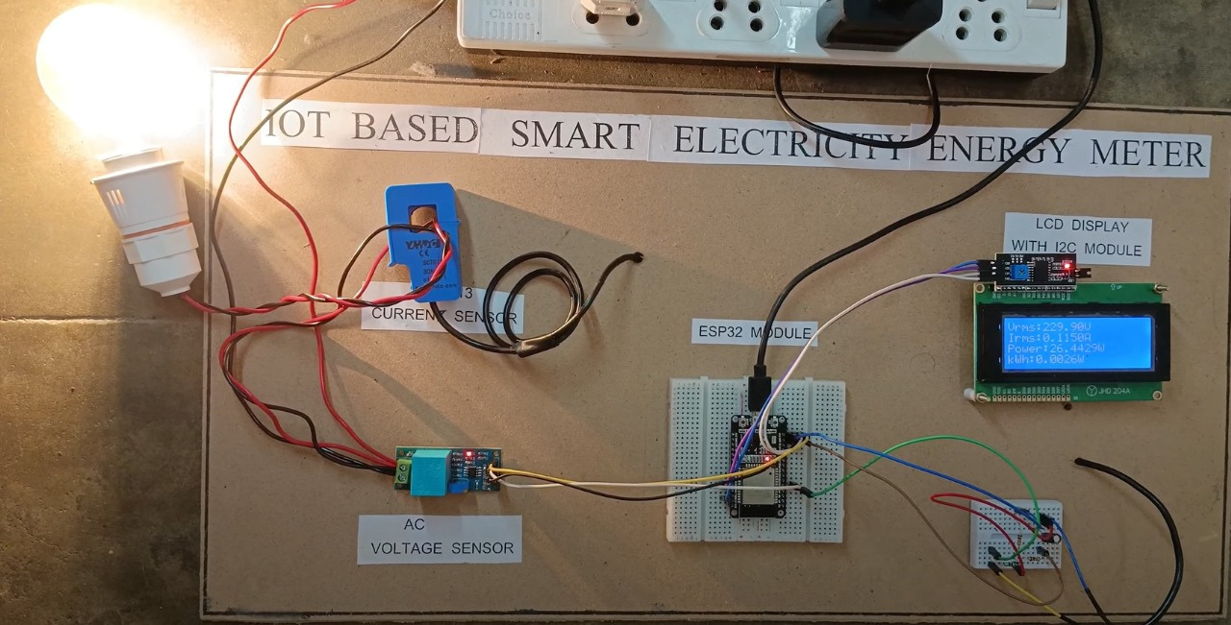
THE CIRCUIT

Slide 11
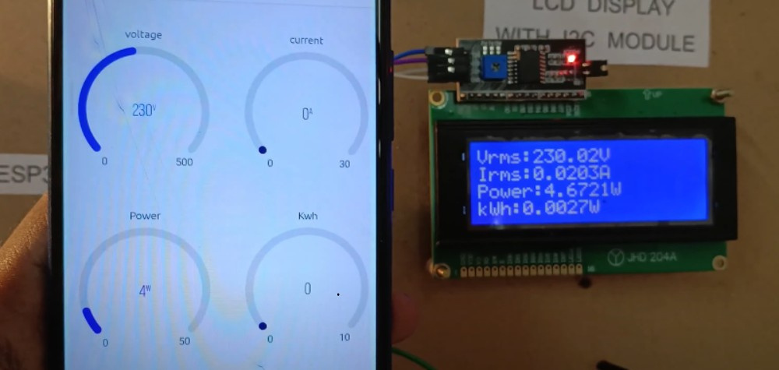
USER INTERFACE
What the user inteface would look like

Slide 12
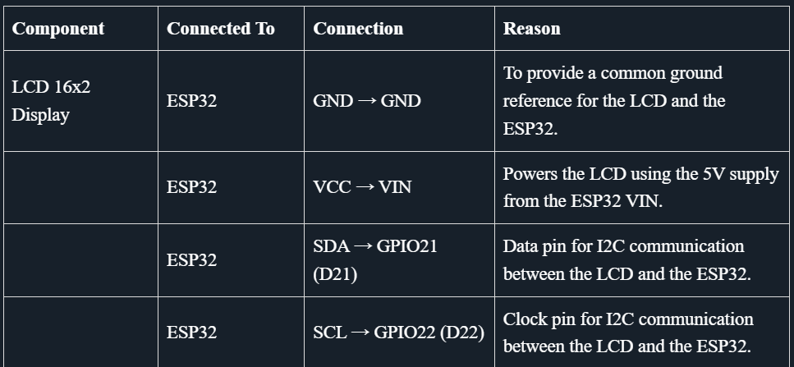
CIRCUIT CONNECTIONS

Slide 13
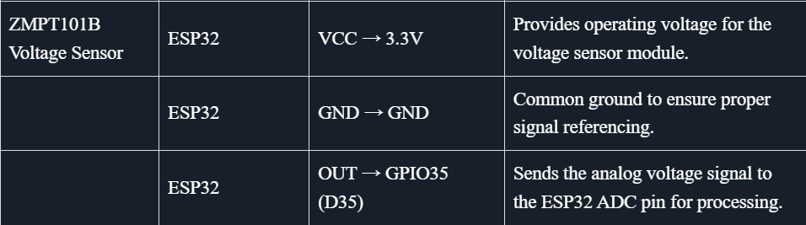

Slide 14
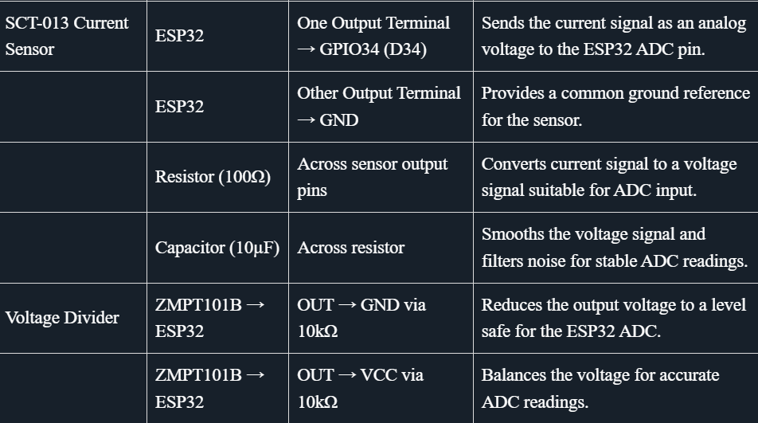

Slide 15
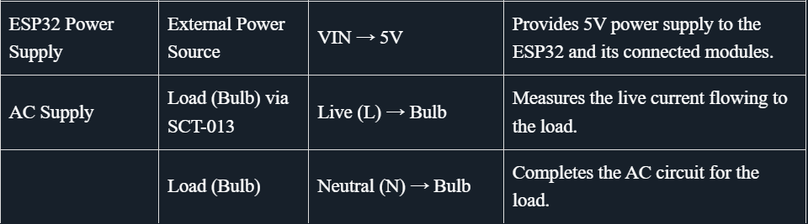

Slide 16
ADVANTAGES AND LIMITATIONS
Advantages
Real-Time Monitoring: Users can track energy consumption instantly, enabling proactive management of electricity usage.
Cost Management: Allows users to monitor electricity usage trends and estimate monthly bills to avoid unexpected costs.
Data Logging: Stores historical data for analysis, helping users identify patterns and make informed decisions on energy conservation.
Customizable Thresholds: Users can set energy usage thresholds to receive warnings when approaching limits.
User-Friendly Interface: Offers intuitive dashboards for easy understanding of energy data, suitable for all types of users.

Slide 17
ADVANTAGES AND LIMITATIONS
Limitations
High Initial Cost: Smart meters require expensive hardware and setup.
Internet Dependency: IoT-based meters rely on a stable internet connection for remote monitoring.
Scalability Issues: Large-scale implementation, especially in industrial setups, can be costly and complex.
Privacy Concerns: Continuous data collection raises concerns about user data security.

Slide 18
CONCLUSIONS
The IoT-Based Demand Side Management System enables real-time monitoring and efficient control of electricity consumption.
Users can track and optimize their energy usage remotely by integrating ESP32, smart sensors (SCT-013 & ZMPT101B), and the Blynk 2.0 app.
The system helps reduce energy wastage, lower electricity bills, and promote sustainable energy use.
Despite challenges like internet dependency and initial setup costs, the system provides a scalable and efficient solution.
Future scope
Advanced Analytics: Incorporating AI for predictive energy usage patterns and recommendations to save electricity.
Enhanced Automation: Automating energy-saving actions, such as turning off appliances when not in use, for smarter energy conservation.
Improved Scalability: Expanding the system to monitor and manage energy for industrial or commercial building

Slide 19
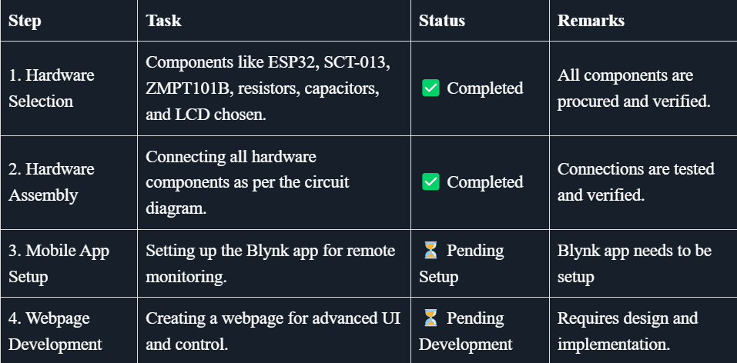
TIMELINE

Slide 20
THANK YOU

